Slide 1

ACTIVE DIRECTORY INFRASTRUCTURE ADMINISTRATION
Submitted by
NISHI CHAUDHARY
171510032
Department of Computer Engineering and Applications
Institute of Engineering and Technology
GLA University
Mathura-281406,INDIA
2019

Slide 2
ACTIVE DIRECTORY INFRASTRUCTURE ADMINISTRATION
USING VIRTUALIZATION IN VMWARE WORKSTATION

Slide 3
CONTENTS
INTRODUCTION
IT INFRASTRUCTURE v/s VIRTUALIZATION
KEY FEATURES OF VIRTUALIZATION
WHAT IS HYPERVISOR?
TYPES OF HYPERVISOR
VMWARE ESXi
WHAT IS ACTIVE DIRECTORY DOMAIN CONTROLLER?
WORKING OF THE PROJECT

Slide 4
INTRODUCTION
Technology used: Virtualization
Tools used: VMware Workstation, vSphere Client, vCenter Server
Implementation of: Active Directory Domain Controller

Slide 5
VIRTUALIZATION
Virtualization is the process of running a virtual instance of a computer system in a layer abstracted from the actual hardware
Find out more at the PowerPoint Getting Started Center
(Click the arrow when in Slide Show mode)
Notes:
In Slide Show mode, click the arrow to enter the PowerPoint Getting Started Center.

Slide 6
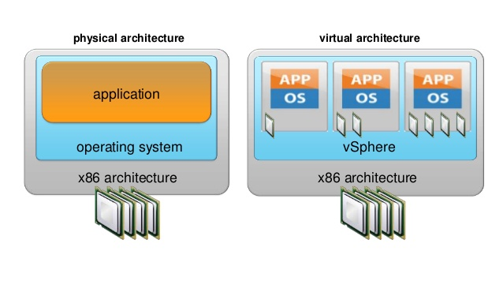
IT INFRASTRUCTURE v/s VIRTUALIZATION
WITHOUT VIRTUALIZATION
Setup Configuration
Maintenance, Support
Require Real Estate
Require Cooling
Require Power
WITH VIRTUALIZATION
Reduced Cost
Rapid Provisioning
Flexibility & Automation

Slide 7
HYPERVISOR
A hypervisor or virtual machine monitor (VMM) is computer software, firmware or hardware that creates and runs virtual machines.

Slide 8
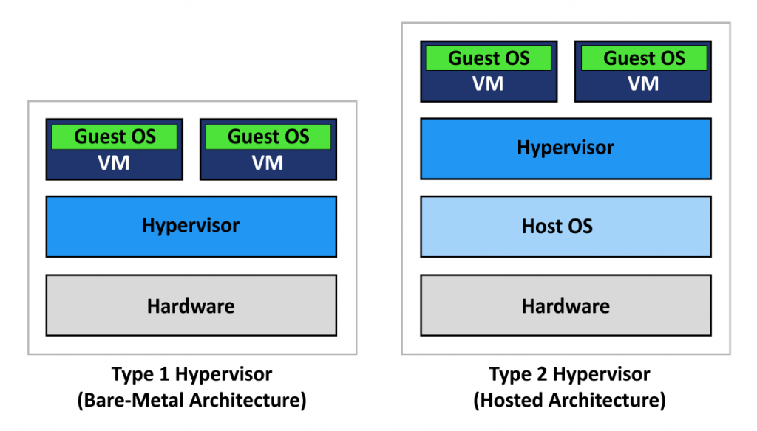
TYPES OF HYPERVISOR
Type 1 hypervisor: Hypervisors run directly on the system hardware – A “bare metal” embedded hypervisor.
Type 2 hypervisor: hypervisors run on a host operating system that provides virtualization services, such as I/O device support and memory management.

Slide 9
VMWARE ESXI
VMware ESXi is an enterprise-class, type-1 hypervisor developed by VMware for deploying and serving virtual computers.

Slide 10
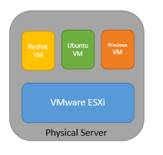
ESXi
Bare-metal hypervisor that installs directly onto your physical server. With direct access to and control of underlying resources.
→Partitions hardware to consolidate applications
→Cut costs
→Efficient architecture
→Reliability
→Performance

Slide 11
ACTIVE DIRECTORY DOMAIN CONTROLLER
A directory service, such as Active Directory Domain Services (AD DS), provides the methods for storing directory data and making this data available to network users and administrators.

Slide 12
STEPS FOR CREATING DOMAIN CONTROLLER
Add the Active Directory Domain Controller role in the Server Machine.
Launch the Domain Controller.
Create a Domain Name.
Add users to the Server.

Slide 13
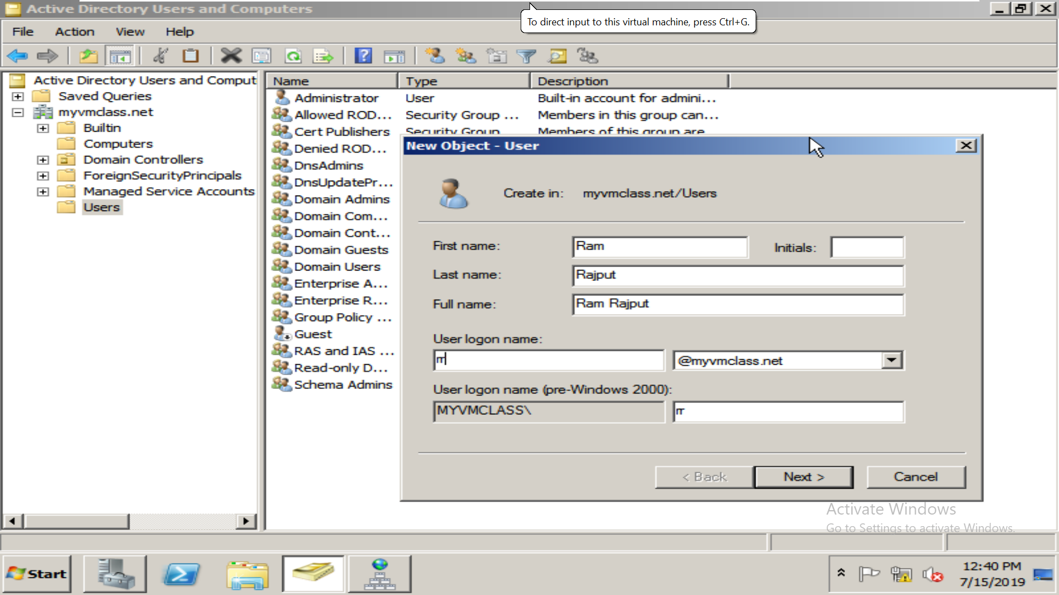
WORKING OF THE PROJECT
Creating Users

Slide 14
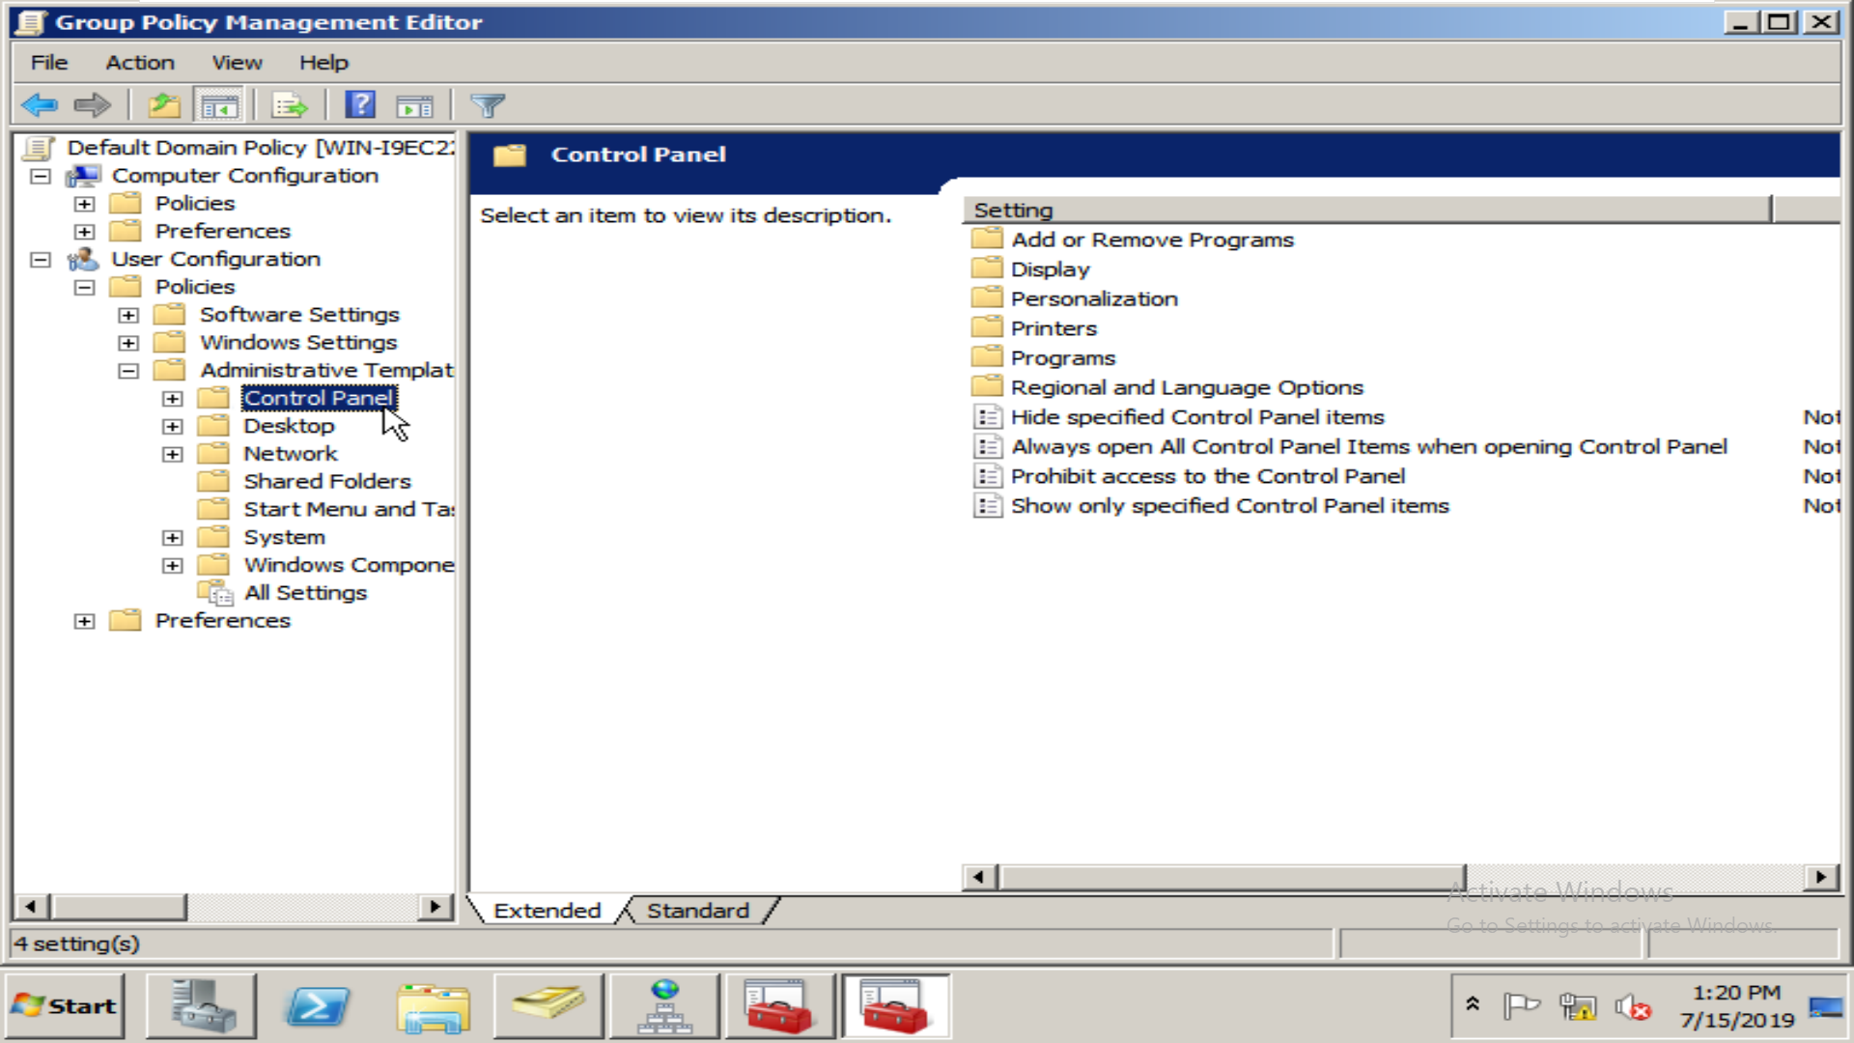
WORKING
Applying Group Policy

Slide 15
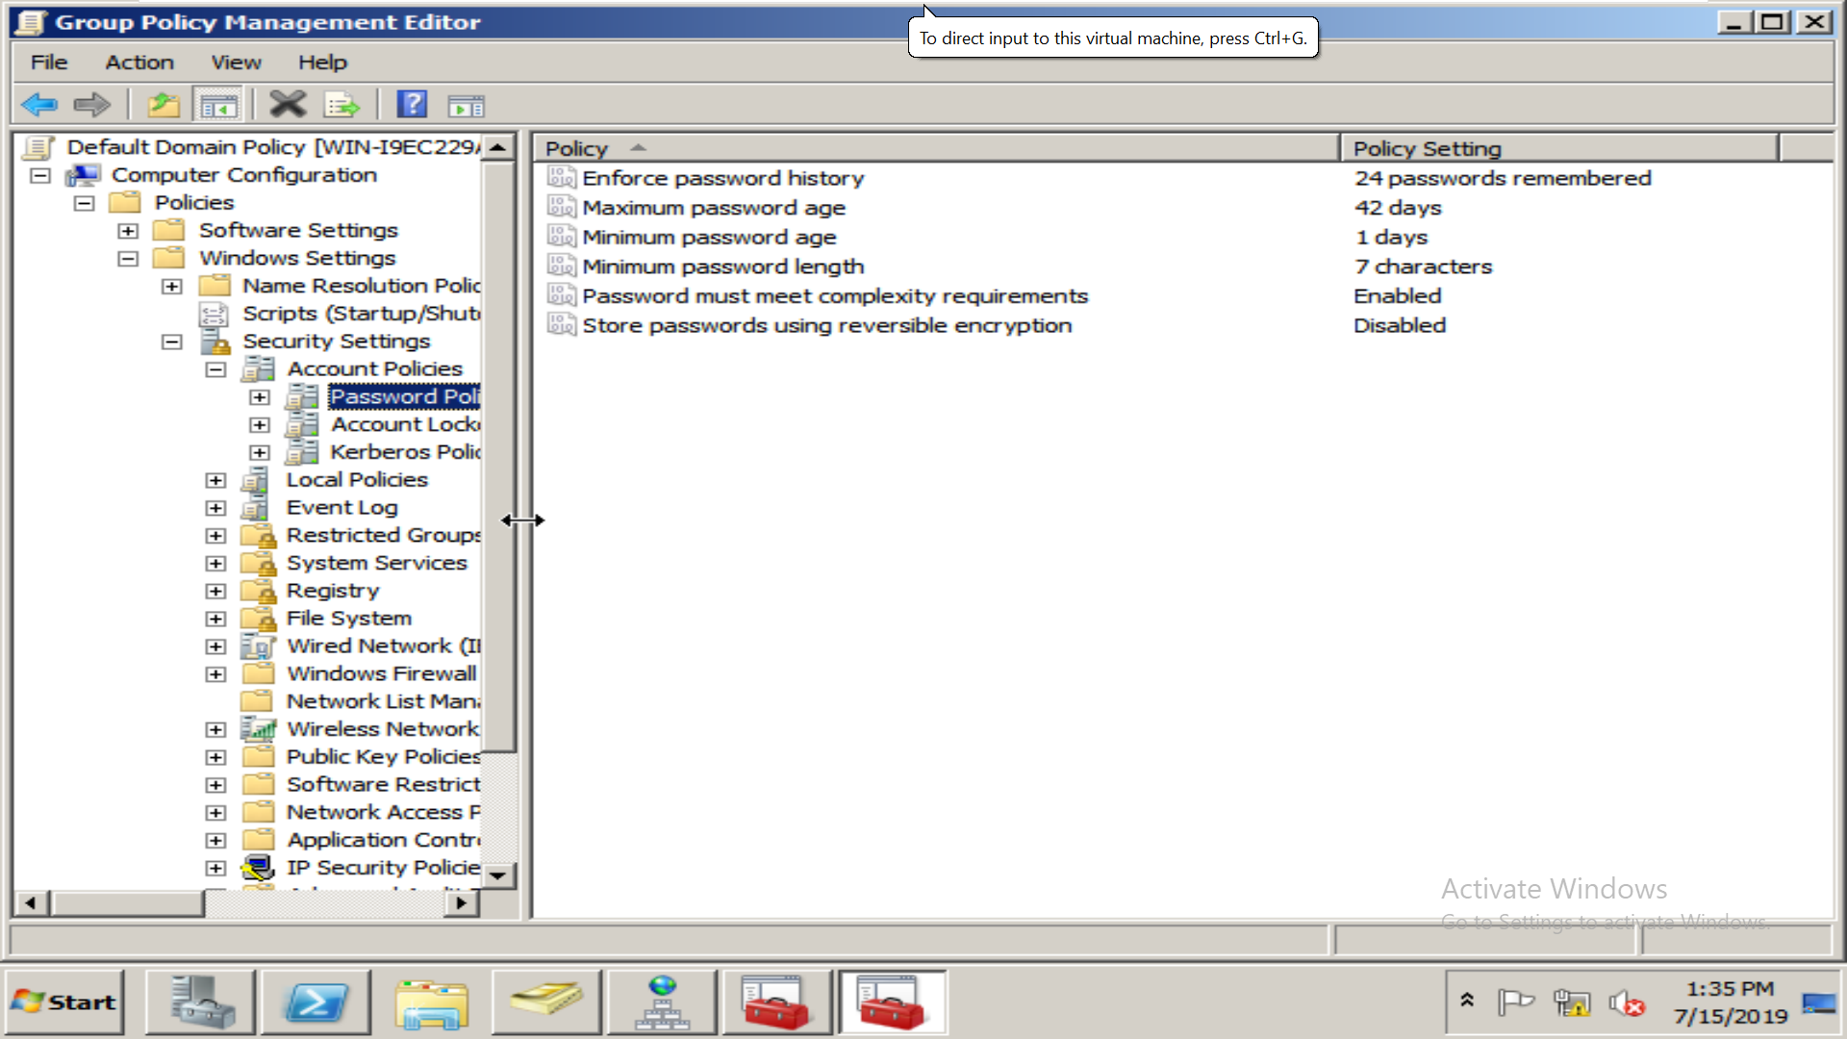
WORKING
Managing the policies of users

Slide 16
THANK YOU

